Slide 1

IMAGE COLORIZATION
WEBSITE
Team members:
Abdul Aziz Miya(21095)
Salina Bajracharya(21122)
Saroj Neupane(21127)

Slide 2
Topics
Introduction of project
Problem Statement
Objective
Literature Review
Methodology
Results
Conclusion

Slide 3
Introduction
"Image Colorization Website" is Django based website
allows users to upload a grayscale image and color it
allows users to download and share
used Sequential model for image colorization
The model consists of Auto encoder
Auto encoder consists of layers of CNN

Slide 4
Problem Statement
to predict the most plausible color version of a old grayscale image

Slide 5
Objective
To implement the CNN auto encoder for image colorization
To develop the website where user can upload the black and white image and color the image and download it

Slide 6
Literature Review
"Image Colorization Using Convolutional Auto encoders.“
-convolutional neural networks (CNNs)
Lewinson, Eryk. "Image Colorization Using Convolutional Auto encoders.“
- ues ColorNet for image colorization
- predict the chrominance values of an input grayscale image
Arumugam, A., & Rajaram, R. (2022)."image colorization using deep learning“
-Use convolutional neural networks (CNNs) and generative adversarial networks (GANs)

Slide 7
Methodology

Slide 8
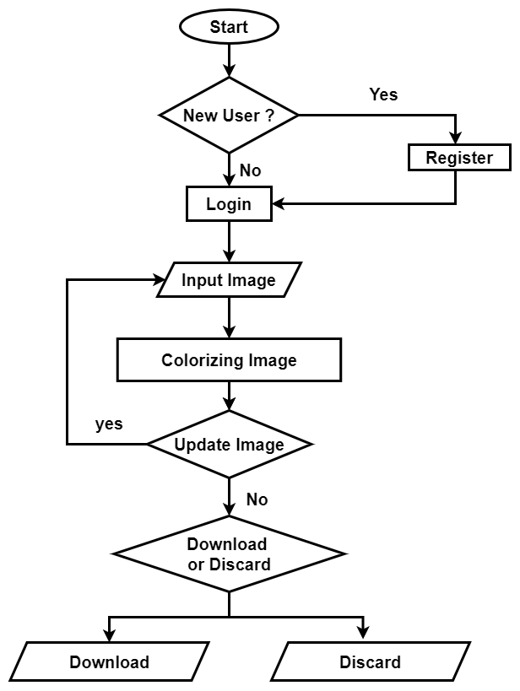
Fig 1: Flowchart of Image Colorization Website

Slide 9
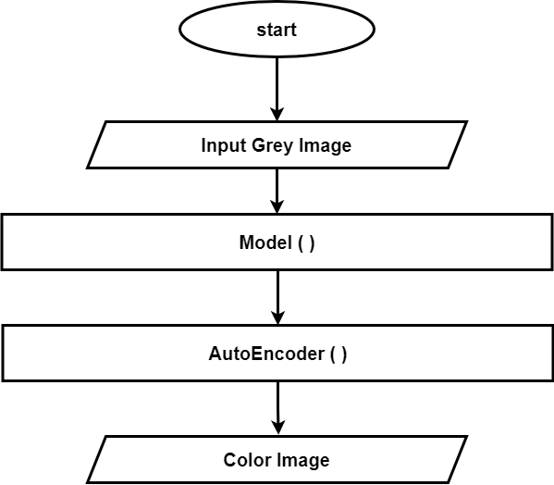
Fig 2: Flowchart of Colorization

Slide 10
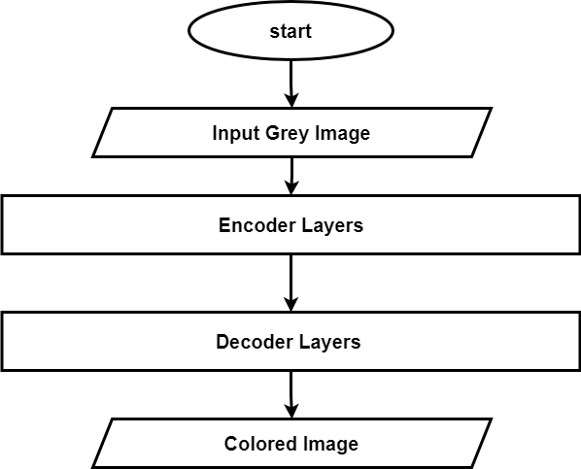
Fig 3 : Flowchart of Auto-Encoder

Slide 11
Result
Train Dataset: 90%
Test Dataset: 10% Batch_size :16
Epoch | Loss (Training)% | Accuracy (Training)% | Val_loss (Validation)% | Val_Accuracy (Validation)%
100 | 0.0064 | 0.8163 | 0.0164 | 0.779
200 | 0.0022 | 0.9071 | 0.0116 | 0.788
300 | 0.0025 | 0.89 | 0.0112 | 0.792

Slide 12
Conclusion
We were able to design an auto encoder using CNN
Able to train the Auto encoder with our train and test dataset
Able the trained model and saved it
Able to integrate the model into the website where users can upload and color their old images.

Slide 13
Thank You
Any Question???

